Slide 1


Loan Repayment Assessment in Banking
Task is to build and train a model that identifies a customer will repay or default from the loan dataset
BY Shivam Namdeo

Slide 2

Accurate prediction of repayment behavior contributes to maintaining a healthy credit portfolio, attracting investors, and sustaining the long-term financial health of the lending institution. This task is at the intersection of data analysis, machine learning, and financial risk management, offering opportunities to optimize decision-making processes and enhance customer experience.

Slide 3

How to achieve this
By creating a Machine learning model to predict that the lean will be paid or defaulted based on the historical data training and predicting on the present data provided that necessary values for the features are provided

Slide 4

Necessary libraries :
pandas numpy as np
seaborn as sns
Matplotlib
re
datetime
scipy.stats
imblearn
Sklearn
xgboost
warnings

Slide 5

Steps Involved :
✓Statistics descriptive analysis ✓EDA ✓Data preprocessing ✓Feature scaling ✓Feature engineering ✓Feature selection ✓Build model ✓Ensemble techniques - Bagging, Boosting ✓Cross validation ✓Grid search, Tuning Hyper parameters ✓Evaluation metric: F1 - Score

Slide 6
Data Preprocessing
emp_length column is converted into numerical.
emp_title column missing values are imputed by creating a new category 'Not Specified'.
Missing values were handled by imputation or filling with a placeholder case being median and modes
Skewness of the features checked and Outliers were treated by clipping based on the interquartile range (IQR) method.
Feature Engineering
New features created :
region : Grouped the address states by region they belong.
credit history : To record days since the borrower's earliest reported credit line was opened and present.
fico_score_average : The average of high FICO and low FICO range.
Class Imbalance Management
Using SMOTE(Synthetic Minority Over-sampling Technique)

Slide 7
Models used for ML
1 LogisticRegression classifier
2 Gaussian Naive Bayes classifier
3 Linear SVM classifier
4 BaggingClassifier
5 AdaBoostClassifier
6 Random Forest classifier
7 XGBoost classifier

Slide 8

Model Optimization and Outcome
Performed stratified cross-validation , GridSearchCV and hyperparameter tuning
Feature Importance Analysis
Analysis by feature importance produced by Random Forest classifier and XGBoost classifier
Outcome
Based on the metrics, the XGBoost classifier outperformed the other models in terms of accuracy, precision, recall, and F1-score. Achieving F1 score of 0.87. Choose XGBoost as the primary model for prediction. further hyperparameter tuning can be done for XGBoost to potentially improve performance.

Slide 9
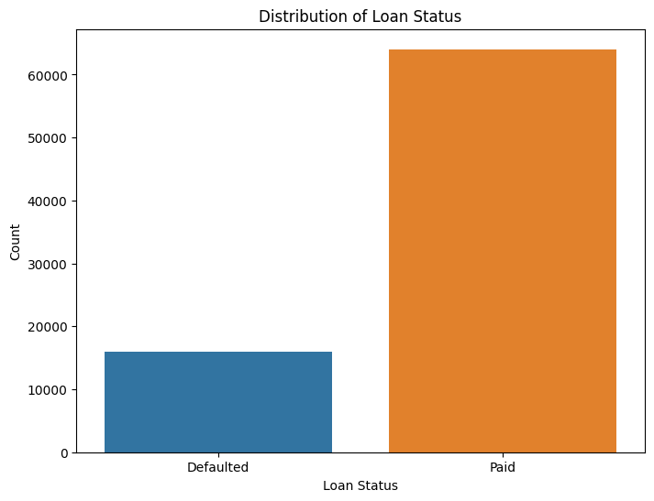
Train data In percentage terms
Paid 80.0375 Defaulted 19.9625

Slide 10
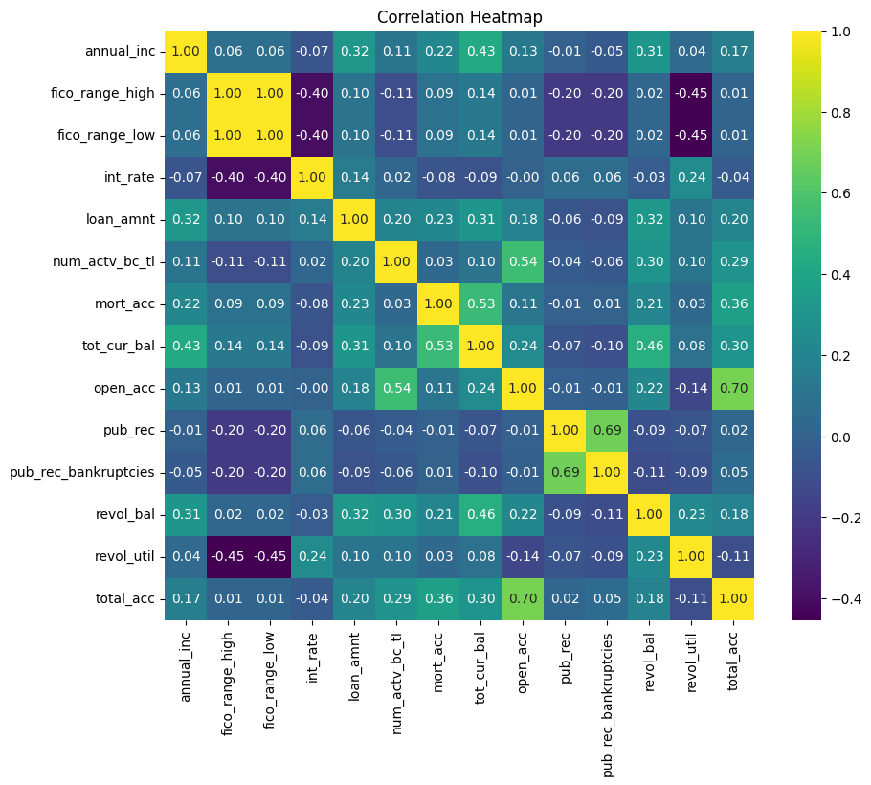
Correlation heat map of numerical columns

Slide 11
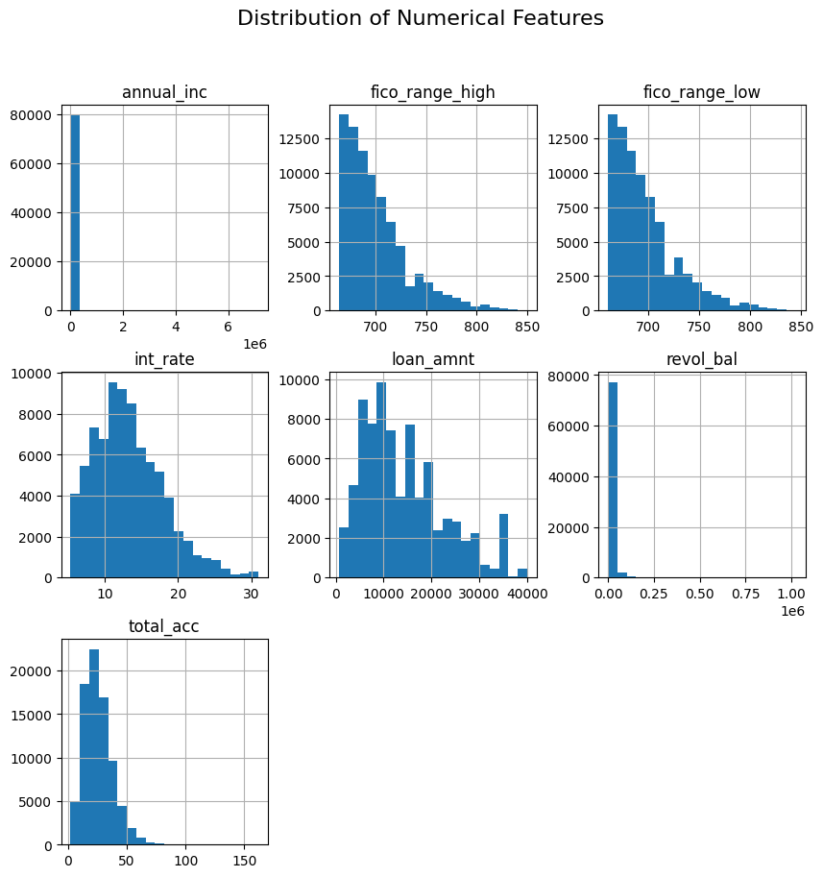
Visualization of important numerical columns via histograms

Slide 12
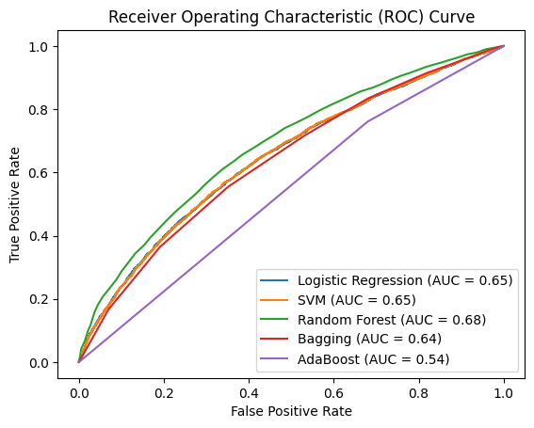
Performance of models on metric ROC AUC

Slide 13
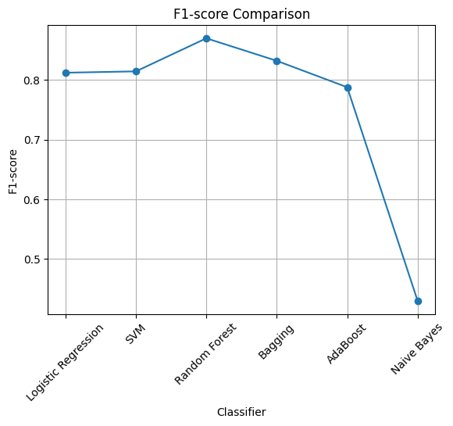
The Scoring metric performance F1 Score of tried models :

Slide 14
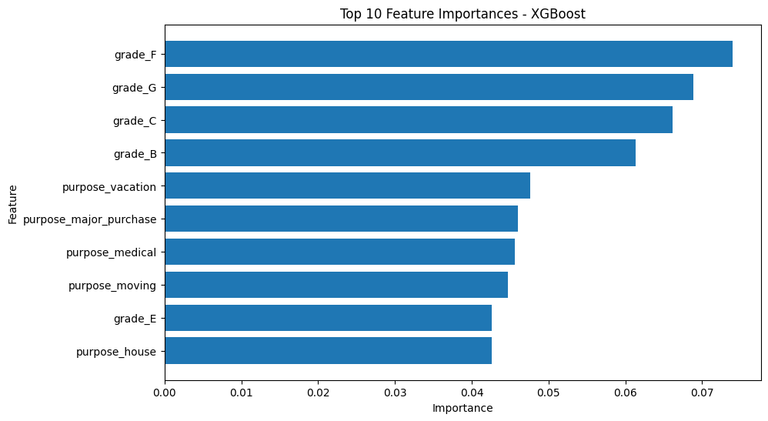
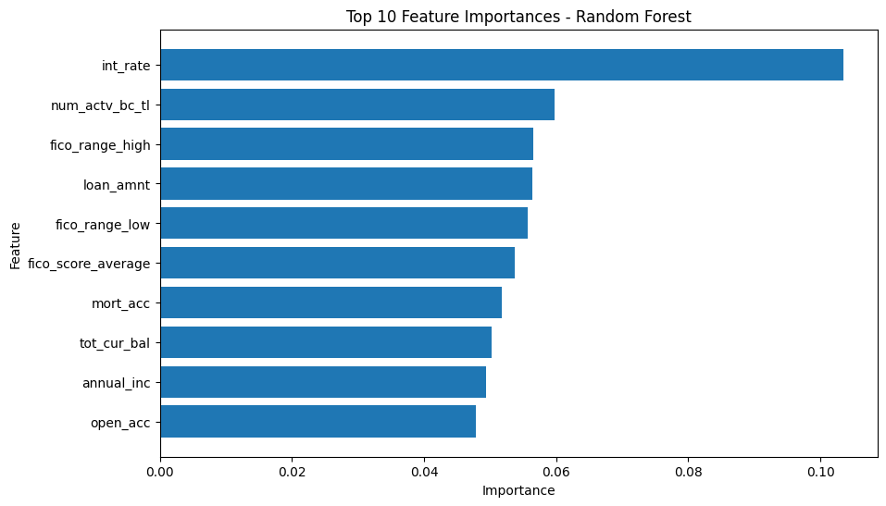
Feature importance as judged by RandomForestClassifier and XGBoostClassifier

Slide 15
Final Analysis on chosen model:
XGBoostClassifier
Accuracy: 0.78
The accuracy score of approximately 78.8% indicates that the model's overall performance is good in correctly predicting both positive and negative cases.
Precision: 0.81
The precision score of around 81.2% suggests that when the model predicts a loan as paid, it's correct about 81.2% of the time.
Recall: 0.95
The recall score of about 95.7% indicates that the model is very good at identifying loans that are actually paid among all the loans that are paid in reality.
F1-score: 0.87
The F1-score, which balances precision and recall, is also high at around 87.8%, indicating a good balance between correctly identifying paid loans and avoiding false positives.
Confusion Matrix:
The confusion matrix shows the counts of true positive, false positive, true negative, and false negative predictions. The model correctly predicted 379 paid loans and 12234 unpaid loans, with a relatively low number of false positives and false negatives.
Best Hyperparameters: {'learning_rate': 0.1, 'max_depth': 10, 'n_estimators': 100}

Slide 16

Thank you By SHIVAM NAMDEO

